Slide 1
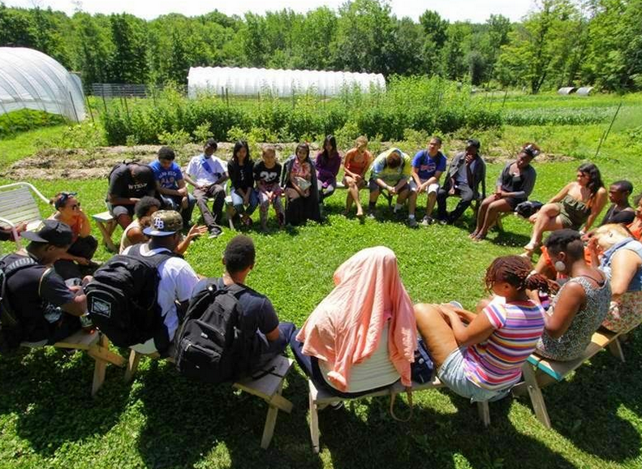
Urban Gardening for Urban Solidarity

Slide 2
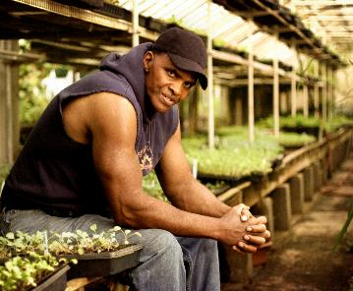
Black Farmers in

Slide 3
Black Farmers in

Slide 4
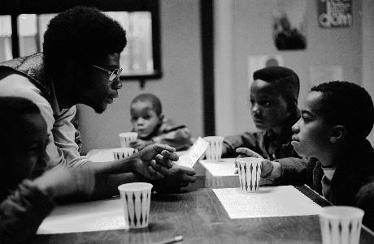
Importance of Food beyond eating
Backbone of the civil rights movement
Gives people an opportunity to be equal participants
A place were people learned to work together

Slide 5
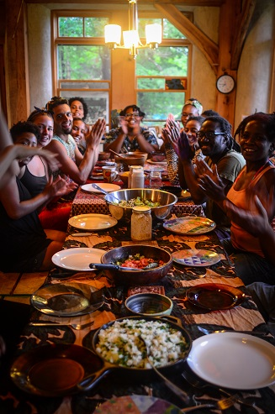
Example: Soul Fire Farm: a Certified Naturally Grown family farm just outside of Albany, NY
Food Sovereignty Education
Black and Latino Farmers Immersion
Volunteering
Farming Apprenticeship
Youth Program
International Solidarity
Activist Retreats

Slide 6
Thomas Jefferson envisioned
American democracy as a nation of independent farmers. As common people lost the “means of production” the worst impact landed on blacks, Latinos and other vulnerable populations. It is a political
problem, not just a health problem.
Farmers (Urban and Rural)
Produce Food, work and materials
City Laborers
Work in Factories, stores all over cities
Present Day
Temp work
and service industry as unions and skilled labor vanishes
Notes:
Black in American = Entrepreneurial skills
Food – Labor – culture
Problems associated with black farming isn’t exclusive, but it is important to understand

Slide 7
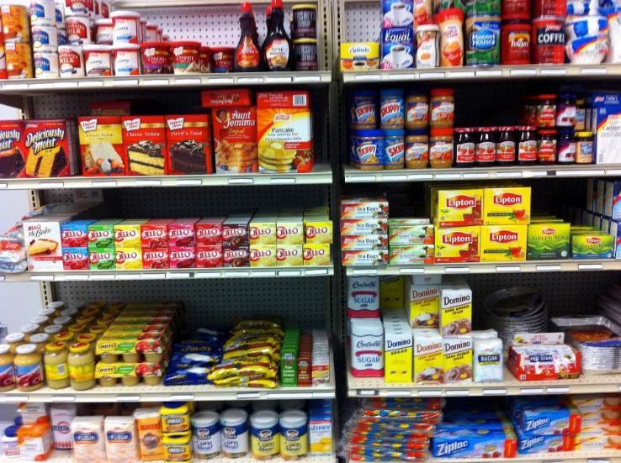
Food deserts are defined as parts of the country vapid of fresh fruit, vegetables, and other healthful whole foods, usually found in impoverished areas. This is largely due to a lack of grocery stores, farmers' markets, and healthy food providers.
Notes:
Food Deserts

Slide 8
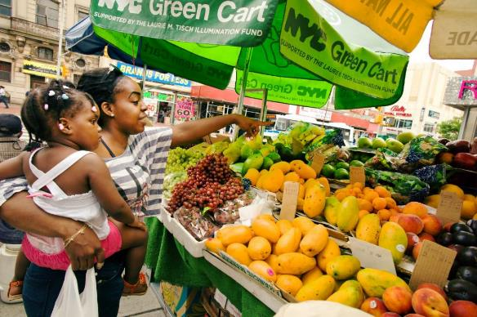
Part of the food justice movement is making healthy fresh foods more available through urban farmers markets

Slide 9
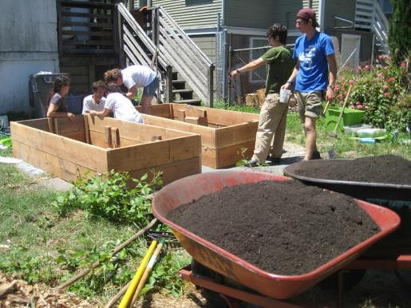
Another part of the food justice movement is growing food in urban spaces such as vacant lots

Slide 10
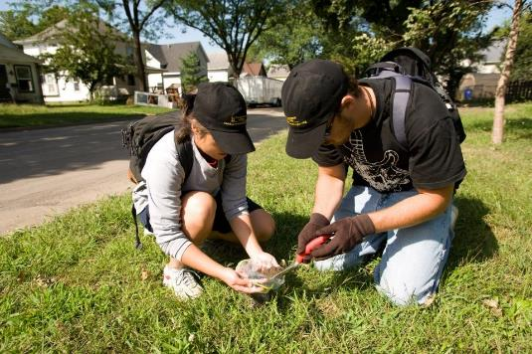
Science and technology education can also be an empowering part of urban agriculture, providing lessons with a meaningful context

Slide 11
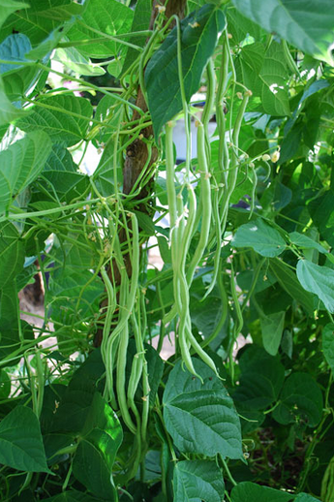
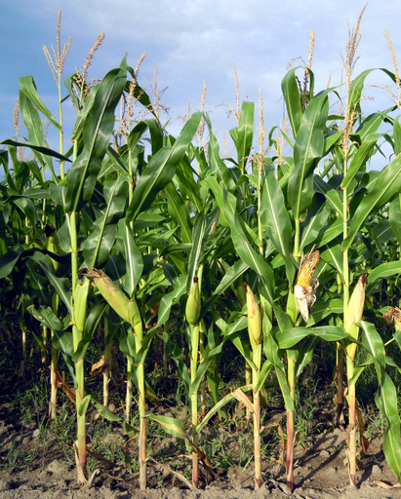
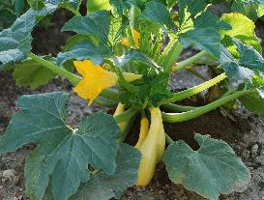
Intercropping is a way that “non-human” participants (plants, worms, etc.) can use solidarity to help each other. Native Americans called corn, beans and squash the “three sisters” for this reason.
Bean roots have bacteria that can take nitrogen from the air and make it available in the soil
Corn stalks help
bean vines climb to get more sun
Squash’s spiny leaves
repel pests and prevent evaporation
Notes:
elps: Beats, Eggplant, Pumpkins and Squash

Slide 12
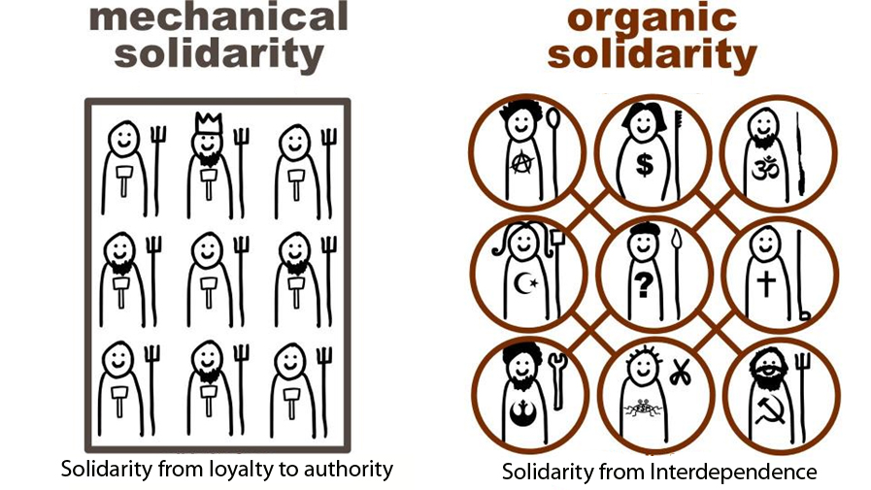
What is “solidarity”? When peasants follow a king or soldiers take orders from a general they are acting out of loyalty to authority. But
when urban gardening brings people together their solidarity is based
on a sense of interdependence.

Slide 13
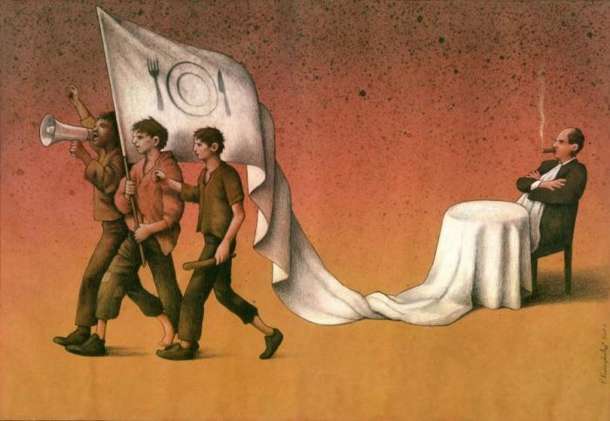

Slide 14
How Can Solidarity Help?
E-Waste
Urban Gardening
Maker Spaces
Solidarity

